Slide 1
MIS547
Cloud Computing

Slide 2
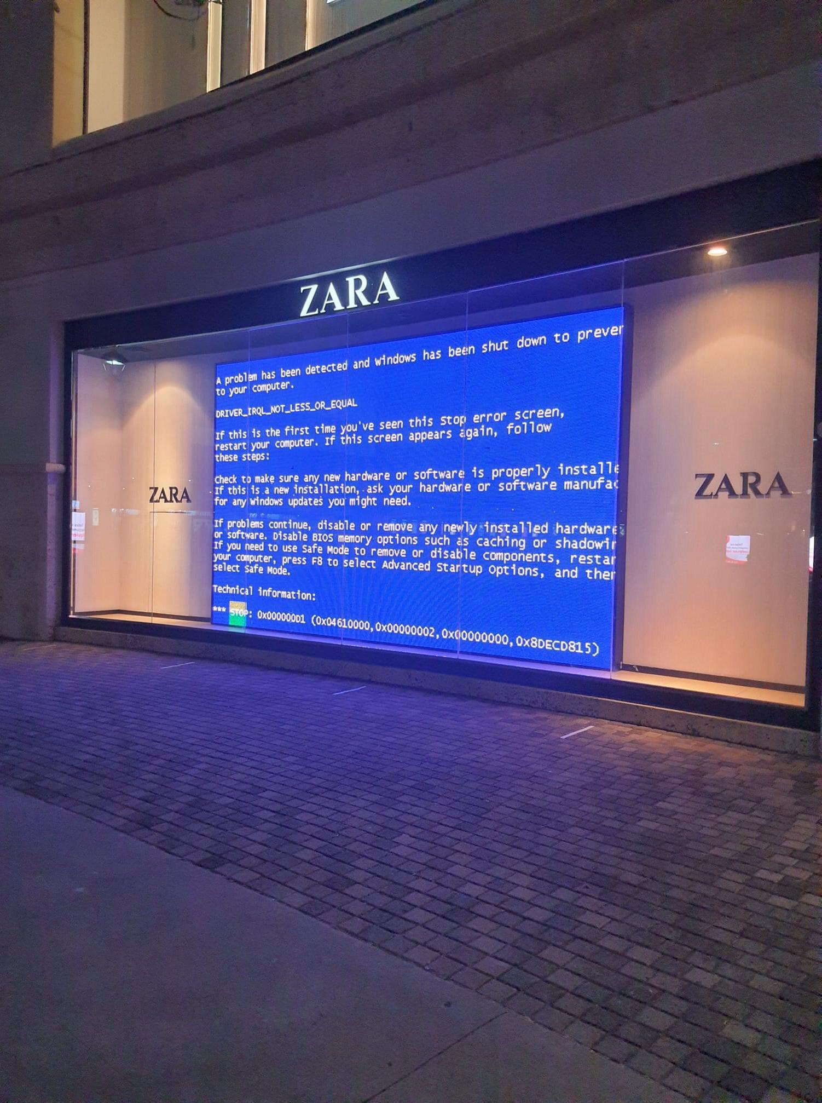
About Your Instructor
Zara Ahmad-Post
Security Data Science @ DigitalOcean
Adjunct Faculty @ University of Arizona
Founder, Director of R&D @ Z Collective

Slide 3
Goals for this Course
Compare and contrast
Compare and contrast the major communities and corporations in the cloud industry
Gain
Gain familiarity with major cloud-hosted and cloud-native technologies
Evaluate
Plan and evaluate cloud-hosted and cloud-native architectures
Describe
Describe security and privacy concerns in cloud environments
Make
Make sound recommendations regarding cloud technologies and articulate the rationale behind cloud business decisions

Slide 4
Syllabus Overview
Unit 1: Cloud Fundamentals
Unit 2: Cloud-Native Technologies
Unit 3: Special Topics
MLOps
Serverless
Compute
Database
Network
Microservices
Infrastructure as Code
Kubernetes
DevOps
Storage
Notes:
the syllabus is a bit of a living document.
I want to make sure that you are all getting what you want out of this course, and I want to make it challenging but not technically overwhelming.
We do have three key sections to the semester
The special topics section is going to be somewhat guided and defined by you! I don’t know your journey, I don’t know what you love to learn about, so we’re leaving a bit of wiggle room in this section so that you can determine what it is you’d most like to get some familiarity with before you * graduate *
have a course “pre-assessment” set up in D2L for you all to complete before the next lecture

Slide 5
Course Structure
Weekly Assignments
Due following Sunday @ midnight
Weekly Quizzes
Due following Sunday @ midnight
Recorded Lectures
In-class lectures are recorded
Some lectures will be online only
Open Sundays @ midnight
Open Thursdays @ 5pm
Office Hours
(by appointment)
Professor Z:
Vetri:
Fri @ 11am
September 14
Wed @ 3pm

Slide 6
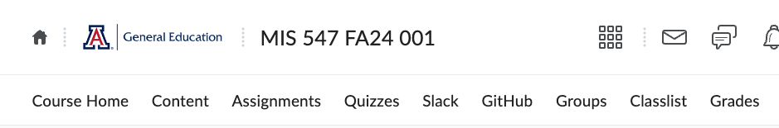
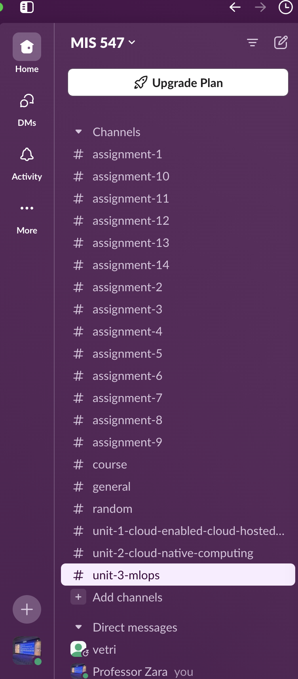
Communication Guidelines
We will be using Slack for communication (see D2L navbar)
Please post questions in Slack in public channels
We have a Slack citizenship guide in D2L
If a personal request or grading question, email or DM me is fine

Slide 7
Important Dates
Exams
Exam 1: SEPTEMBER 26
Exam 2: NOVEMBER 5
Exam 3: DECEMBER 3
Presentations:
Day 1: DECEMBER 5
Day 2: DECEMBER 10

Slide 8
Extra Credit Opportunities
Debugging
Slack participation
Community involvement
Course evaluations and surveys
Extra Credit
See Syllabus or Getting Started sections in D2L for details

Slide 9
Policy on Usage of Generative AI
You may not use generative language models to create any written materials in this course.
You may use CoPilot, but…
<soapbox>Zara’s Disclaimers about Using Generative AI </soapbox>

Slide 10
Due This Week
1. Course pre-assessment
2. Assignment 1- Sunday at midnight
3. Quiz 1- Sunday at midnight

Slide 11

Resources and Course Materials
Fall 2024 Course Funded by DigitalOcean

Slide 12
Lecture 1: WHAT IS THE CLOUD

Slide 13

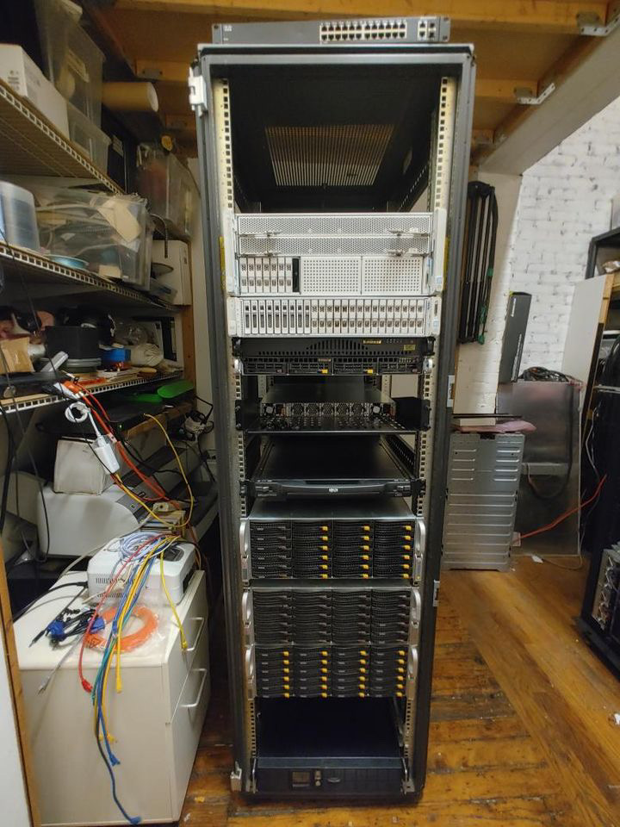
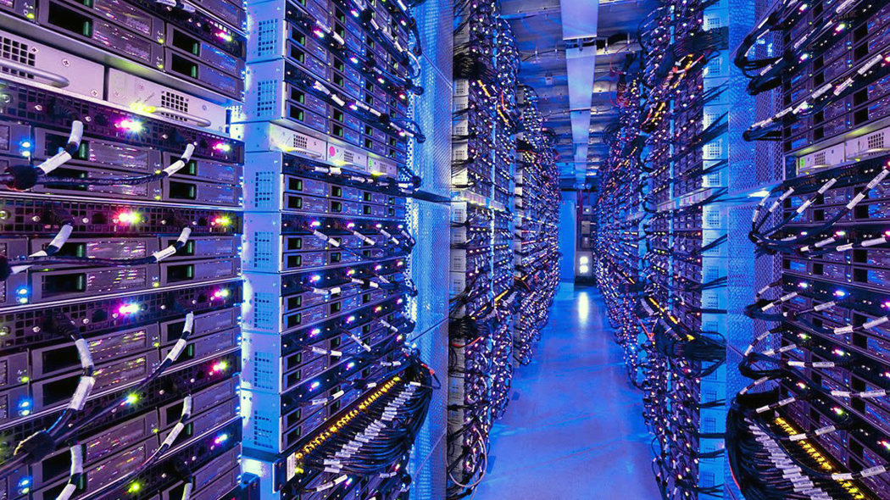
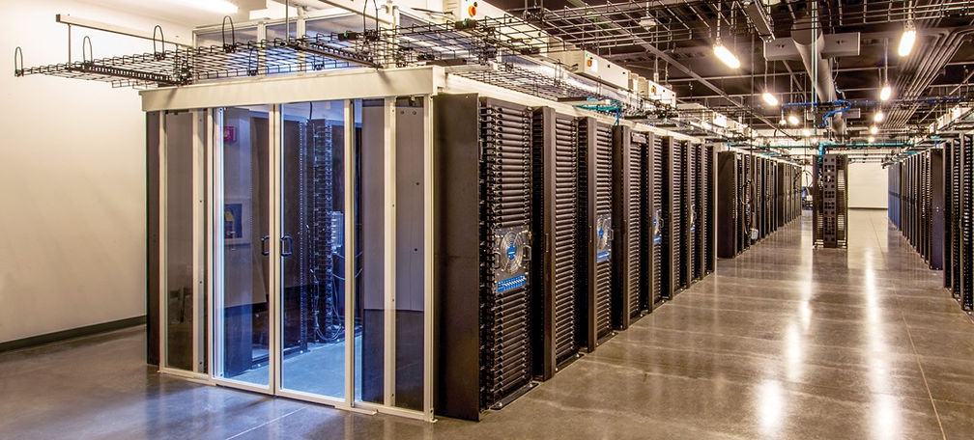
Someone else’s computer
This Photo by Unknown Author is licensed under CC BY-NC-ND

Slide 14
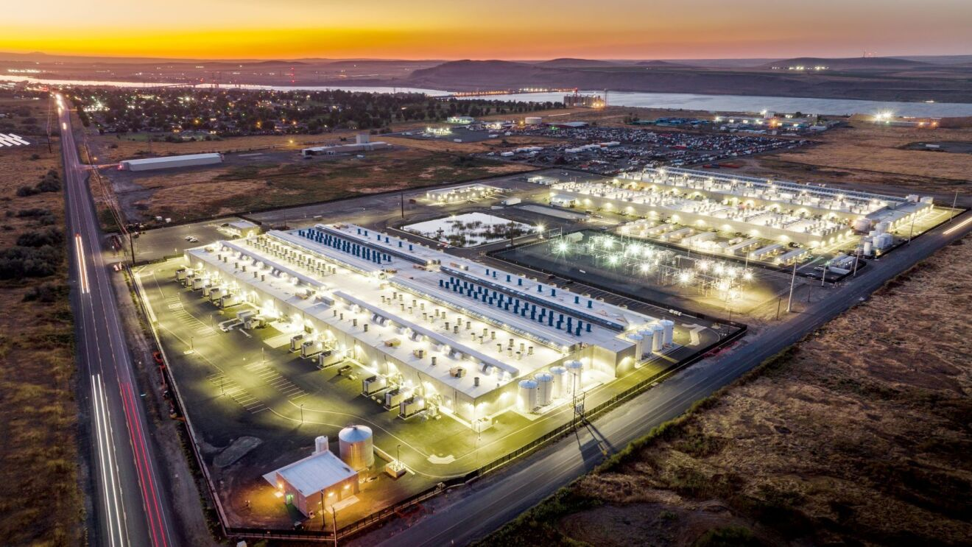
Someone else’s computer
Notes:
These datacenters are just immense. Football field (or several football fields) large, full of server hardware, all of which gets provisioned to clients through systems of virtualization and dynamic scaling. All of which we’re going to explore.

Slide 15
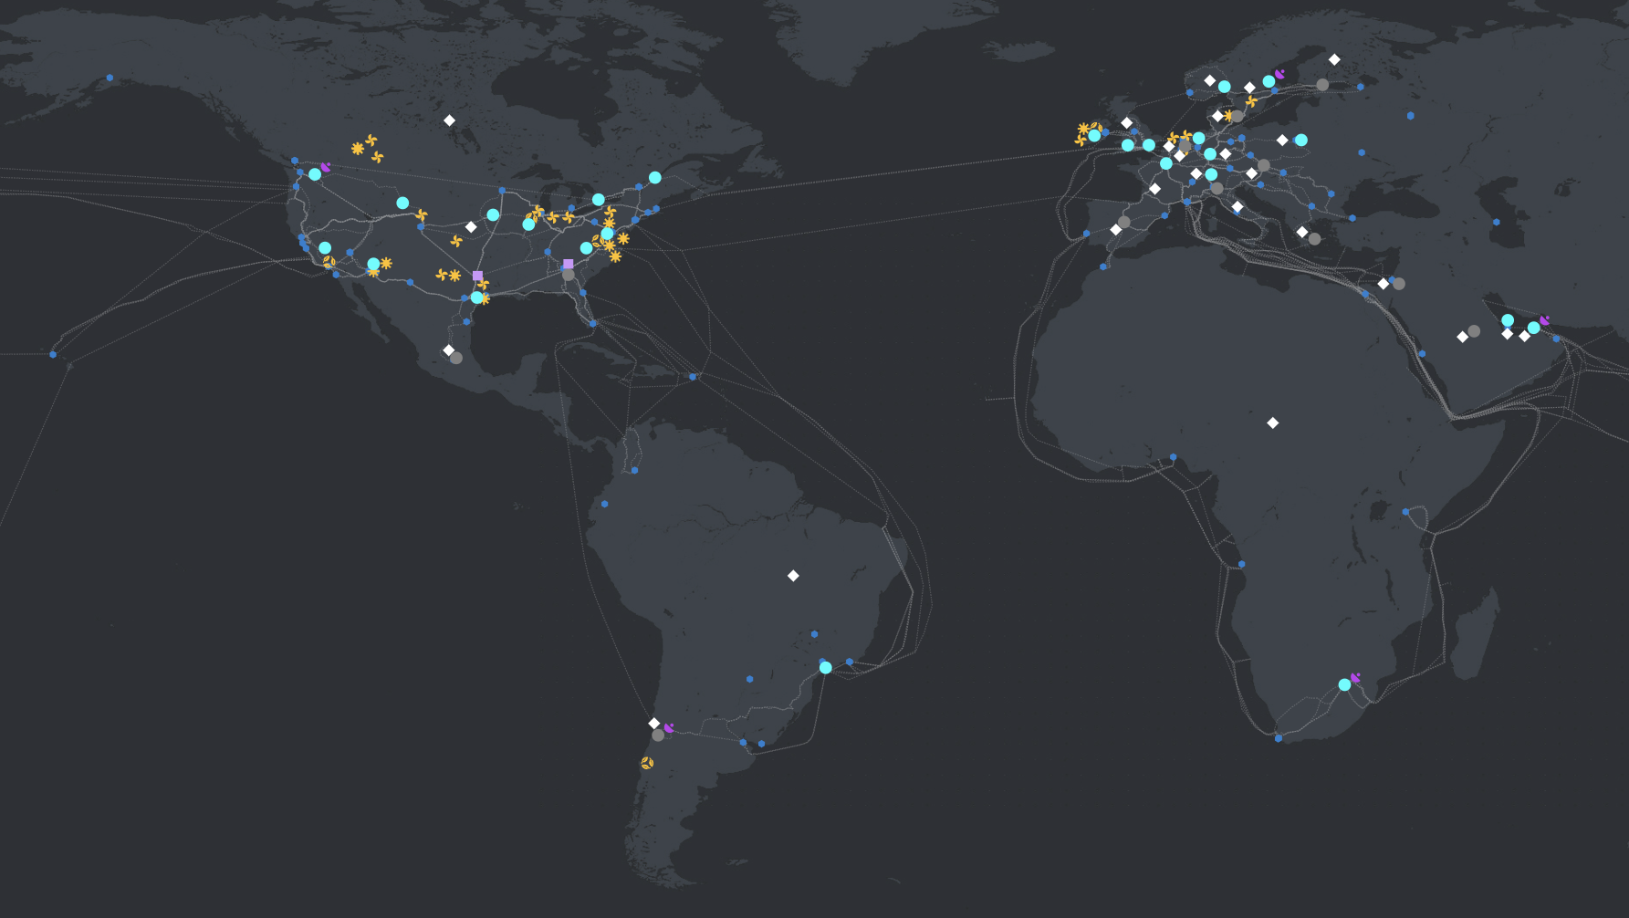
Someone else’s computer: Azure global infrastructure
Notes:
Azure global infrastructure

Slide 16
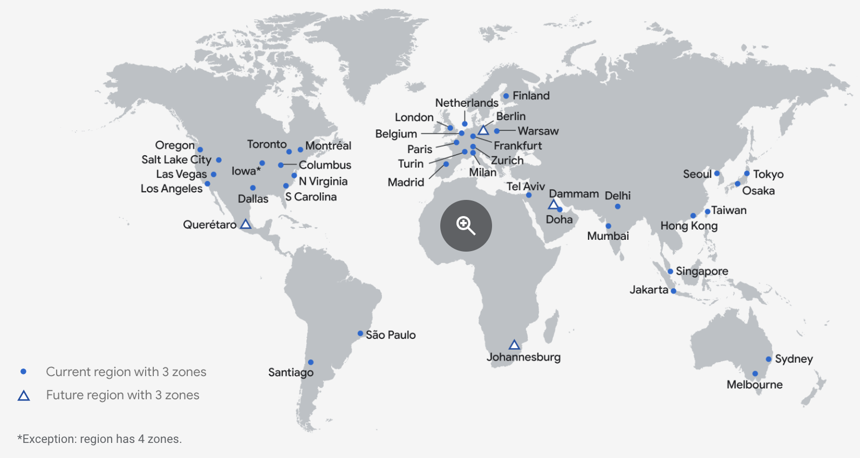
Someone else’s computer: Google Cloud Platform global infrastructure
Notes:
GCP global infrastructure

Slide 17
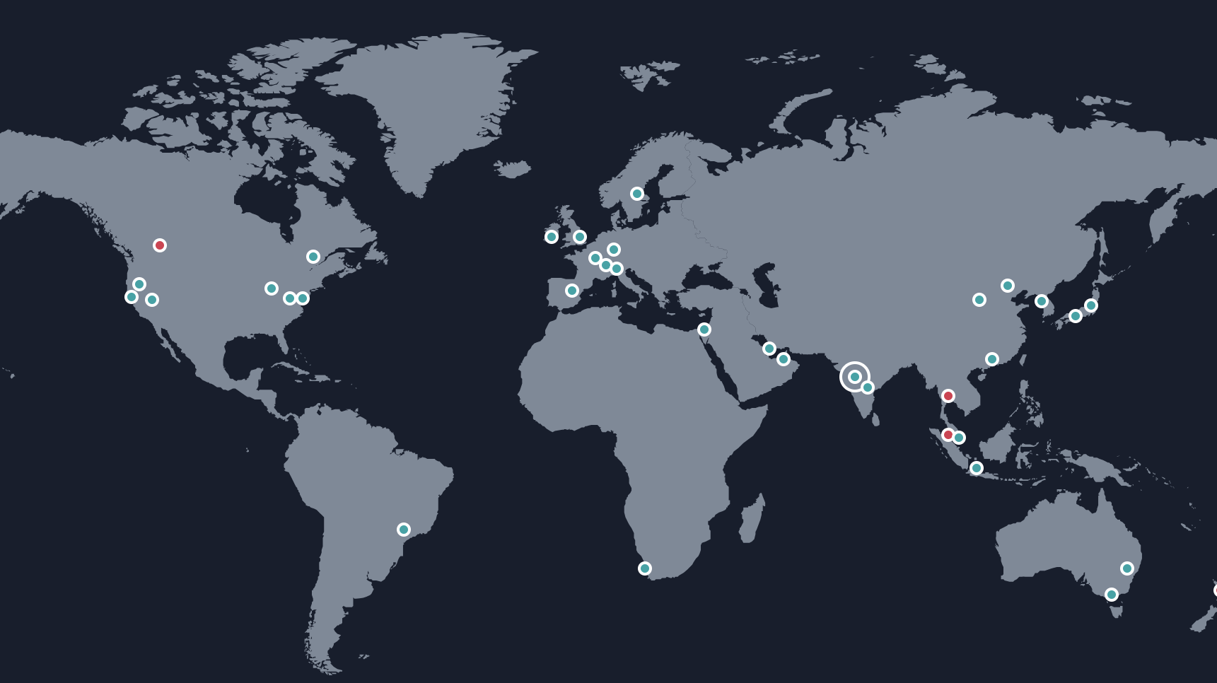
Someone else’s computer: AWS global infrastructure
Notes:
AWS global infrastructure

Slide 18
What is this Class Really about?
Massive global infrastructure, global workforces, hundreds of services… How do we leverage all of this?
What does this mean for us as product managers, project managers, data folk, developers, security experts, privacy champions, global citizens?
How do we turn datacenters into Netflix? How do we turn GPUs into OpenAI?
This class will equip you the knowledge to leverage cloud computing services.
We can’t cover everything… find continuing education resources that work for you!

Slide 19
DEFINING CLOUD COMPUTING
NIST Characteristics of Cloud Computing
On-demand usage (self-service usage)
Ubiquitous* access
Multitenancy (resource pooling)
Elasticity
Measured Usage
Resiliency

Slide 20
DEFINING CLOUD COMPUTING
ON-DEMAND USAGE
A cloud consumer can autonomously access cloud-based IT resources, and self-provision these resources.
The customer doesn’t have to interact with the cloud provider.
They can access their cloud accounts through a web self-service portal to view their cloud services, monitor their usage, and provision and de-provision services.

Slide 21
DEFINING CLOUD COMPUTING
UBIQUITOUS ACCESS*
This is the ability for a cloud service to be widely accessible.
It requires support for a range of devices, transport protocols, interfaces, and security technologies.
In the case of public clouds, access is facilitated via the internet; in the case of private clouds, it’s facilitated through a LAN.

Slide 22
DEFINING CLOUD COMPUTING
MULTITENANCY
Multiple customers can share physical resources using a multi-tenant model.
This model assigns and reassigns physical and virtual resources based on demand.
Multi-tenancy allows customers to share the same infrastructure while maintaining privacy and security.
A cloud provider pools its IT resources to serve multiple customers by using multitenancy models that rely on the use of virtualization technologies.

Slide 23
DEFINING CLOUD COMPUTING
ELASTICITY
The automated ability of a cloud to scale resources as needed in response to runtime conditions or as predetermined by the cloud consumer or cloud provider.

Slide 24
DEFINING CLOUD COMPUTING
MEASURED USAGE
The cloud provider can charge a cloud consumer only for the resources they use and/or for the timeframe during which access to the resource was granted.
Measured usage can apply to billing, but also to general monitoring of resources and usage reporting.

Slide 25
Defining Cloud Computing
RESILLIENCY
A form of failover that distributes redundant implementations of IT resources across physical locations.
This can also refer to the overall ability of a service to recover quickly from any disruption, measured by how fast servers, databases, and networks restart and recover after damage.

Slide 26
Defining Cloud Computing: Cloud Resources
Compute
Database
Storage
Networking
Security

Slide 27
Defining Cloud Computing: Cloud Computing Models
Software as a Service
Platform as a Service
Infrastructure as a Service

Slide 28

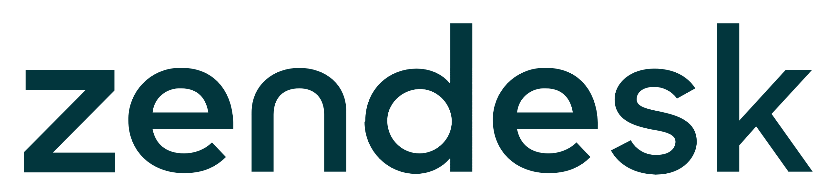
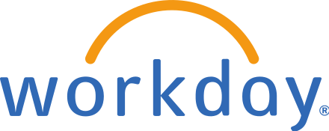
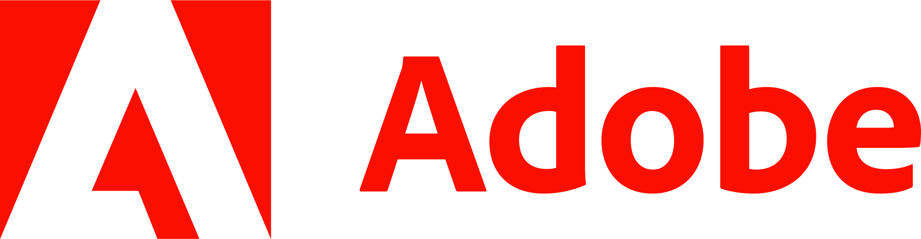


Software as a service
Managed by a service provider
Consumers don’t worry about the underlying infrastructure, maintenance, or management
End-user applications where users only think about how to use and benefit from the product or service

Slide 29

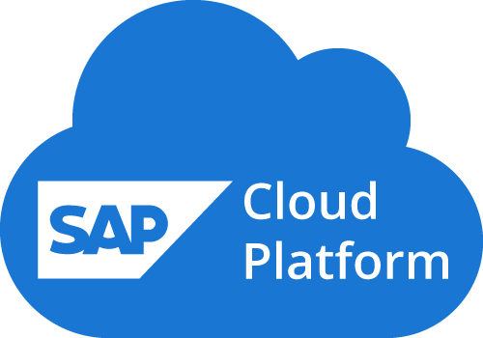
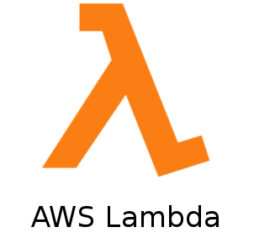
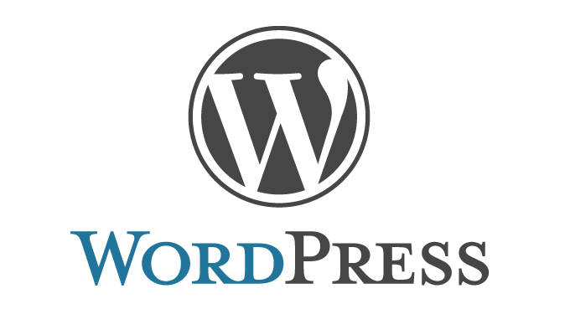
Platform as a service
An environment for engineers to create and deploy applications
Devs don’t worry about the backend infrastructure
Devs don’t configure or manage servers, DBs, datacenters, etc.
PaaS gives more control than SaaS
Notes:
. WordPress functions as PaaS when develoeprs get involved to build different features and functions into the blog.

Slide 30

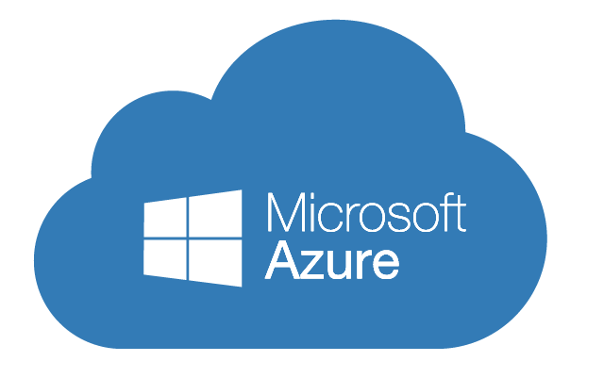
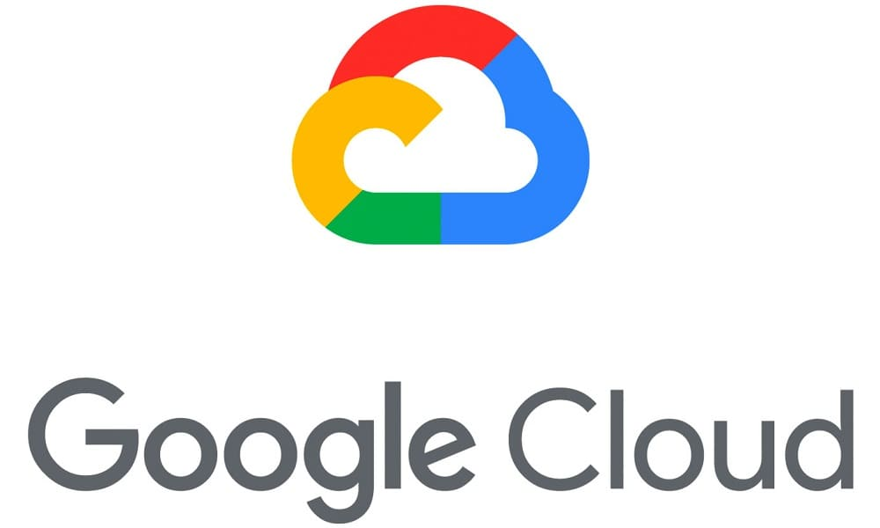
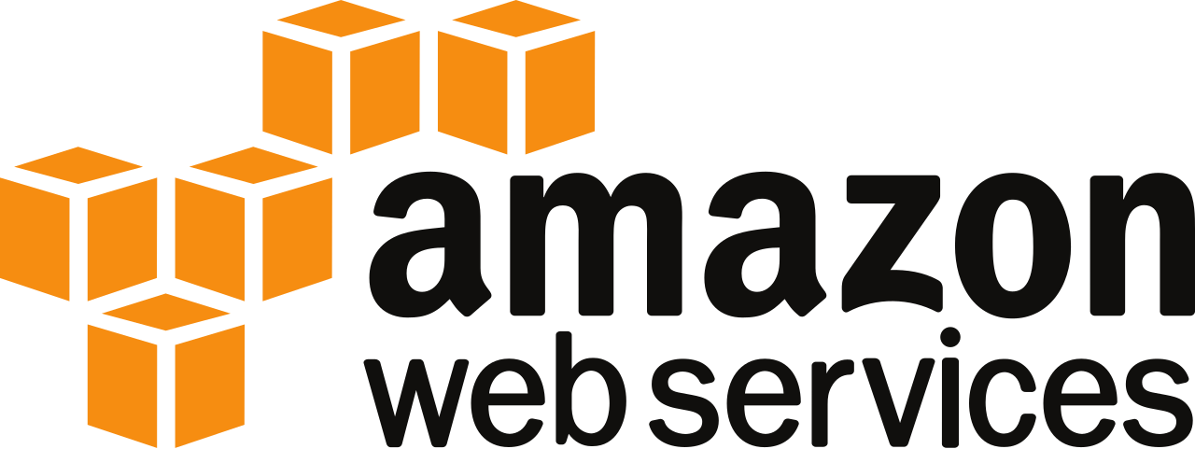
Infrastructure as a service
IaaS == physical/virtual IT infrastructure that a CSP offers
Configure, customize, and maintain a virtual version of your server room/ IT infrastructure
Compute, storage, networking
Requires more engineering than SaaS/PaaS
Most flexibility and customizability

Slide 31
Defining Cloud Computing: Cloud deployment models
Public Cloud
Hybrid
Private cloud
Multi-cloud
Deployment:
The process of setting up computer and network systems so they are ready for use.
The key difference in deployment models is how much control you have over the system.

Slide 32




Public Cloud
Public Cloud Service Provider
Servers
Databases
Enterprise A
Enterprise A Network
Notes:
First up, public cloud. These are you main CSPs, your AWS, Azure, GCP, DigitalOcean, Linode, etc. Basically all parts of the application or infrastructure are deployed in publicly accessible cloud environments owned by a third-party cloud provider. The cloud provider is responsible for the creation and maintenance of the public cloud and its IT resources. When we talk about cloud or cloud native deployments, it generally means that each piece of the application is deployed or lives in the cloud; the application and data were either created ‘in’ the cloud or migrated to the cloud from some existing physical infrastructure. Then users access the cloud via the internet

Slide 33


Public Cloud
Enterprise B
Public Cloud Service Provider
Enterprise B Network
Enterprise C
Enterprise A
Enterprise C Network
Enterprise A Network

Slide 34
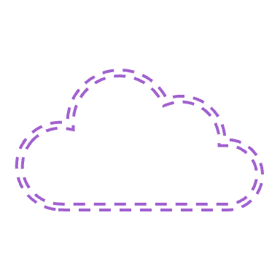
Private Cloud
Private Cloud
Servers
Databases
Enterprise
Enterprise network extended via VPN*
Notes:
Next is the private cloud, which is sometimes also kind of called “on-prem” but not always. Private cloud deployments can literally be on the premises or they can be hosted offsite; it’s really just the fact that we’re also utilizing virtualization and resource management tools offered by cloud computing. So companies utilizing private cloud deployments may still have their physical server rooms and data centers, which means you don’t get all of the benefits of cloud computing but enough benefits exist that it’s one of the core cloud computing deployment types. One benefit could be that the risk of security compromises could be reduced because private cloud deployments allow an organization to fully control and maintain their own networks for the infrastructure, so no part of the infrastructure hits the public internet.
Other orgs may prefer to keep their data in a private cloud for security reasons but still want virtualization and app management resources to increase resource utilization. Private cloud deployments can be a way to get some of the benefits of cloud computing but still keeps legacy IT infrastrcutre intact. And the actual administration of the cloud environments can be carried out by internal staff or it can be outsourced.

Slide 35
Hybrid Cloud
Public Cloud Service Provider
Private Cloud
Enterprise Network
Notes:
Hybrid cloud deployments can be really useful for security reasons, and also for latency reasons. When you’re dealing with extremely large amounts of data, the latency can be noticeable and frustrating for your end users. Any latency can be problematic for day-to-day operations. So hybrid deployments can connect cloud-based infrastructure with existing resources that reside locally, like desktops or servers that live onsite. They can also connect with your private cloud resources. There are a few reasons for using hybrid cloud: you can control costs, you can control how well parts of your infrastructure are managed and secured, you reduce your dependence on another company like AWS, and there are also benefits when it comes to compliance issues, particularly around data and data privacy.
Hybrid cloud use cases generally start from existing on-prem infrastructure; sometimes you need public cloud infrastrcutre to handle bursty traffic during high demand. Sometimes you just need to keep your data in a private cloud but want to utilize the resources for your application in a public cloud.

Slide 36


Public Cloud B
MULTI Cloud
Public Cloud A
Public Cloud C
Enterprise
Notes:
And last, we have multicloud: this entails using two or more public clouds for your workloads. You can replicate the same workload on multiple clouds for higher availability, in case one provider goes bankrupt or has an outage. You can split workloads across multiple clouds; there can be a considerable difference between clouds when it comes to specific tasks and services. Maybe you want to use AWS for web apps, but use GCP for big data processing and analytics for your engineering team; and then for your internal enterprise data you want to use Azure instead of dealing with on-prem licensing for your office subscriptions. Basically with multicloud you pick and choose the best features from each cloud provider.
Mergers and acquisitions can sometimes lead to multicloud deployments; company A acquires company B, and company B’s enterprise productivity tools are all google workspace but company A’s tooling is all Microsoft 365, or company A has their applications and data in GCP but company B is using Linode. Whatever the use case, multicloud is challenging. You’re dealing with multiple different environments and your IT and devops teams have to manage them. Each cloud provider is going to have their own APIs and services. There are distinct certifications for each cloud, right? So some companies end up having dedicated teams for each cloud.
Migrations aren’t easy either, even for cloud-native applications, which are supposed to seamlessly transition between platforms. You sometimes have to re-architect, and the challenges involved in that rearchitecting can lead to vendor lock-in. There are tools and design patterns that we can use to limit the headache of migrating between clouds, and we’ll discuss those throughout the semester.

Slide 37

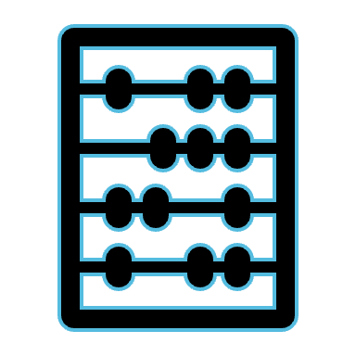




Six Advantages of Cloud Computing

Slide 38
Six Advantages of Cloud Computing
Trade capital expense for variable expense

Slide 39
Six Advantages of Cloud Computing
Trade capital expense for variable expense
Benefit from massive economies of scale

Slide 40
Six Advantages of Cloud Computing
Trade capital expense for variable expense
Benefit from massive economies of scale
Stop guessing capacity

Slide 41
Six Advantages of Cloud Computing
Trade capital expense for variable expense
Benefit from massive economies of scale
Stop guessing capacity
Increase speed and agility

Slide 42
Six Advantages of Cloud Computing
Trade capital expense for variable expense
Benefit from massive economies of scale
Stop guessing capacity
Increase speed and agility
Stop spending money running data centers

Slide 43
Six Advantages of Cloud Computing
Trade capital expense for variable expense
Benefit from massive economies of scale
Stop guessing capacity
Increase speed and agility
Stop spending money running data centers
Go global in minutes

Slide 44
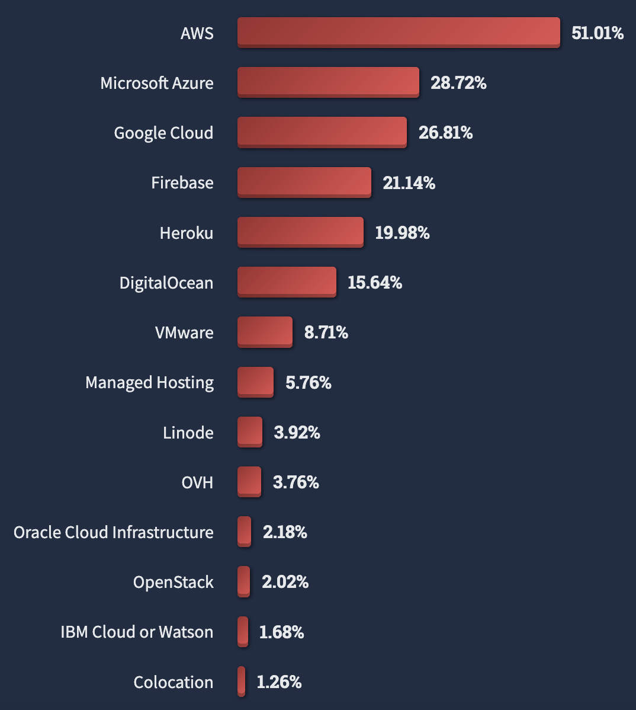
Major Players in Cloud Computing
Source: StackOverflow Developer Survey
Notes:
OK so we generally understand what the cloud is, what deployment models are available, and what a well-designed cloud architecture should include. So let’s look at the major players in this space. I don’t know how many of you check out the stackoverflow developer survey every year, but it is really a gold mine for understanding software engineering at large. The percentages represented here represent the share of developers who have used each of the listed CSPs. AWS, Azure, GCP, Firebase, Heroku, Digital Ocean, Vmware, these are all super high on the list, and are all probably worth at least having some familiarity with. Throughout the course, we’re going to be doing labs utilizing infrastructure from the big 3, and/or if you want, some of the ‘hipster clouds’ as I call them. Or if you know that your future or current employer runs their workloads on IBM cloud, you can make a case for substituting some work on a particular cloud platform that’s of use to you.

Slide 45
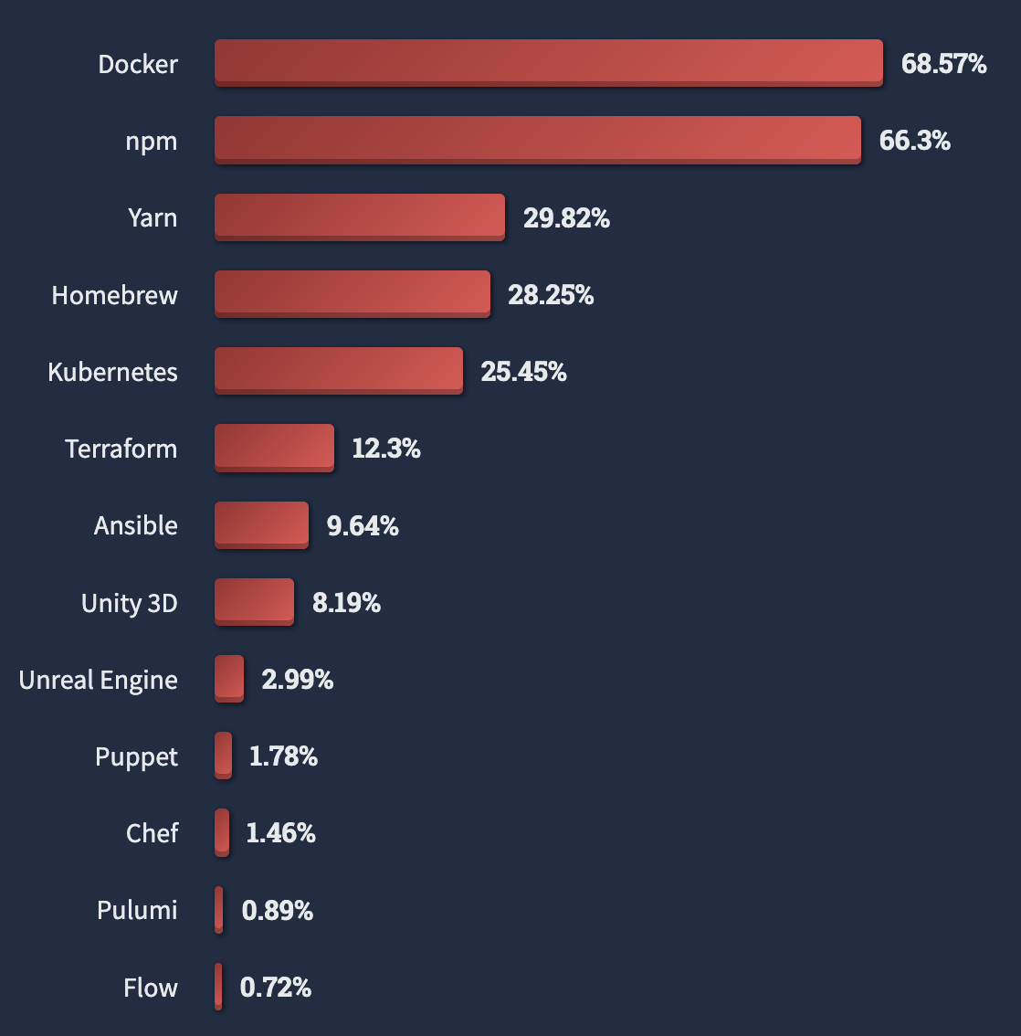
Cloud IS DRIVING TECHNOLOGY ADOPTION EVERYWHERE
Source: StackOverflow Developer Survey
Notes:
Cloud adoption is driving technological infrastructure everywhere. 25% of developers are using Kubernetes, 68% are using Docker. These tools got super popular because of cloud computing, and the portability and reliance they offer throughout the space.

Slide 46
Macroeconomic Landscape: 2023
Tech market downturn
Cost savings are critical
Staffing reduction
Notes:
OK the last thing I want to touch on for this lecture is the larger macroeconomic landscape. We all know about the tech market downturn over the last year and a half. It’s impacted all of us, maybe some of your friends were laid off, maybe you were laid off. Being able to position your organization in the tech market downturn is so, so, critical, and CSPs are aware of how important cost savings are to you. If we’re able to really make the most out of this current landscape- through efficient use of cloud technology, or through automation that helps you and your coworkers not feel overworked, or through just having the critical knowledge needed to survive and thrive in this landscape, then we’re all in a good spot. So all of these benefits of cloud computing aren’t just technological, this is now kind of survival. Not to be dramatic, and I don’t want to catastrophize. It’s just we all kind of have an obligation now to make sure we’re up-to-speed on these cloud computing topics.
That’s part of why I really am interested in your feedback in the D2L quiz 0, which is just the pre-assessment. I know what’s important to us over on the cloud side, now you get to help dictate what’s important to you on the product side. So let’s all workshop this new class together, and make it what we need it to be, but also what future students need it to be. Does that sound good to everyone?
OK great, so yes, D2L pre-assessment is available. Lecture 1 readings are available. Lecture 2 and 3 readings will come out on Thursday. Thank you all for being here. I’ll be doing office hours in the lobby until I figure out where they’re actually supposed to be.

Slide 47
Macroeconomic Landscape: 2024
AI
Uncertain Market
Security Investment
Notes:
OK the last thing I want to touch on for this lecture is the larger macroeconomic landscape. We all know about the tech market downturn over the last year and a half. It’s impacted all of us, maybe some of your friends were laid off, maybe you were laid off. Being able to position your organization in the tech market downturn is so, so, critical, and CSPs are aware of how important cost savings are to you. If we’re able to really make the most out of this current landscape- through efficient use of cloud technology, or through automation that helps you and your coworkers not feel overworked, or through just having the critical knowledge needed to survive and thrive in this landscape, then we’re all in a good spot. So all of these benefits of cloud computing aren’t just technological, this is now kind of survival. Not to be dramatic, and I don’t want to catastrophize. It’s just we all kind of have an obligation now to make sure we’re up-to-speed on these cloud computing topics.
That’s part of why I really am interested in your feedback in the D2L quiz 0, which is just the pre-assessment. I know what’s important to us over on the cloud side, now you get to help dictate what’s important to you on the product side. So let’s all workshop this new class together, and make it what we need it to be, but also what future students need it to be. Does that sound good to everyone?
OK great, so yes, D2L pre-assessment is available. Lecture 1 readings are available. Lecture 2 and 3 readings will come out on Thursday. Thank you all for being here. I’ll be doing office hours in the lobby until I figure out where they’re actually supposed to be.

Slide 48
REFERENCES
StackOverflow Developer Survey. 2023. Available: https://survey.stackoverflow.co/2023/

Slide 49
LAND ACKNOWLEDGEMENT STATEMENT
We respectfully acknowledge the University of Arizona is on the land and territories of Indigenous peoples. Today, Arizona is home to 22 federally-recognized tribes, with Tucson being home to the O’odham and the Yacqui. Committed to diversity and inclusion, the University strives to build sustainable relationships with sovereign Native Nations and Indigenous communities through education offerings, partnerships, and community service.

